Slide 1
Project #3 - Robot Follower

Slide 2
Current Sprint
Changed requirements
Tweaked Desktop Application
GRPC implementation
Building car kits - configuring raspberry pi’s & servos

Slide 3
Risks & Challenges
Hardware just arrived (batteries not included!)
Separate systems
Wireless network here at school (can’t ssh or lan scan)

Slide 4
Mitigation Plan
Many in-person meetings every week
Testing messaging protocol on local host
Using our own router for a closed network
Study open source repo

Slide 5
Next Sprint
Get Both Cars Moving
Finalize Client
Implement Follower Vehicle Algorithm

Slide 6
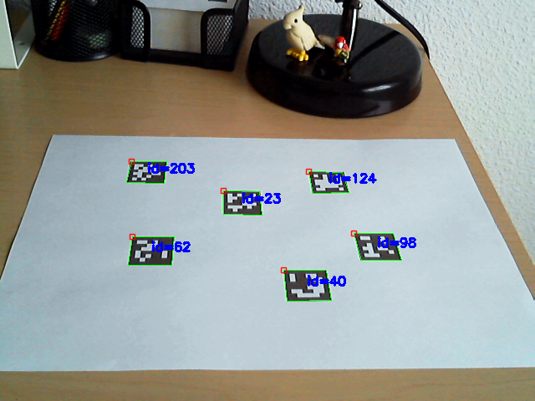
New Image Recognition-Artificial Visual Fiducials
Switched from checkerboard pattern idea.
The unique fiducials allow for easy visual recognition w/ each being numbered.
Very lightweight
Simplifies follower protocol

Slide 7
DEMO

